Slide 1
Modul Pembelajaran [Kode Modul]
[NAMA MODUL]
Page ini diisi oleh Telkom
Pathway | :
Sub Pathway | :
Kompetensi | :
Key Element | :
Level | :
Developer | :
Approval | : | 1. Mgr Learning Development 2. SM School of Dig Platform & Service
Sesuai Dirkom-10
Nama/ NIK/ Bidang
Atau Nama Vendor
Rev. : 00
Created/Last Modified : 10-2021

Slide 2
Modul Pembelajaran | : | React Introduction
Deskripsi Modul | : | React adalah framework untuk bahasa pemrograman Javascript yang digunakan untuk membuat user-interfaces (UI) yang interaktif dan dinamis. React dibangun oleh Facebook pada tahun 2011, dengan rilis ofisial dan umum pada 2013.
Enabling Learning Objective | : | Memahami tentang React sebagai salah satu tool untuk web development
Daftar Topik | : | Why learn ReactJS? Prerequisite for ReactJS Ways to install ReactJS, Using the create react app command | 6. Rethrowing 7. try…catch…finally 8. Global catch
Searching Keyword | : | React JS Node.js NPM and Yarn Git npx install npx create-react-app

Slide 3



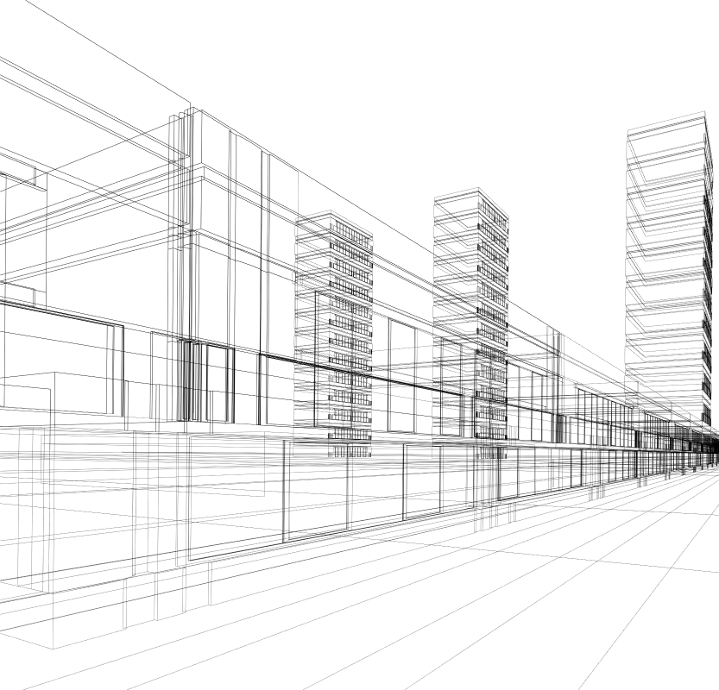
REACTJS
React Introduction
Calvin Susanto Putra

Slide 4
Table of Contents
React.JS Introduction
Why Learn React.JS ?
Prerequisites for React.JS
Ways to install React.JS
Using the create-react-app command

Slide 5

React Introduction
For creating reusable UI components, ReactJS is a declarative, effective, and adaptable JavaScript toolkit.
It is an open-source front end library that is only in charge of the application's view layer.
Jordan Walke, a software engineer at Facebook, developed it.
Facebook created and maintained it at first, and then used it in products like WhatsApp and Instagram.
ReactJS was created by Facebook in its newsfeed area in 2011, but it wasn't made available to the general public until May 2013.
storyset - freepik.com

Slide 6

Why Learn React.JS ?
React is component-based, saving workload and time by breaking down an interface into reusable, modular components to build dynamic UI.
This is how it works:
with a declarative syntax, it cuts down on development time and grants web apps cross-platform capabilities
representing a component’s state simply requires a declaration or utility function
being supported by FAANG companies means that React retains a popular status and strong community support
Cc : Freepik

Slide 7
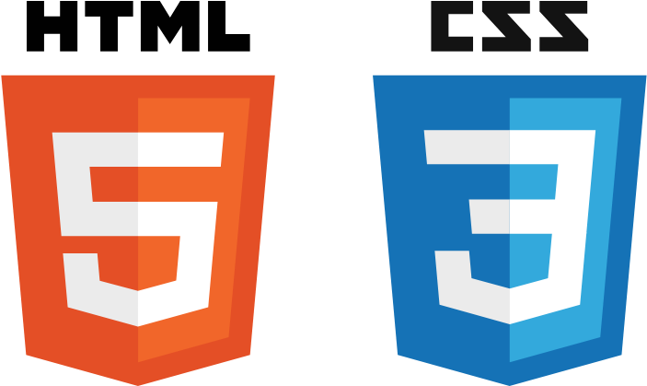



Prerequisites for Learning React
HTML, CSS, JS
An understanding of ES6/7 concepts
Node.js and CLI (command-line interface)
NPM or Yarn package managers
Git version-control system
Cc : Freepik

Slide 8
Prerequisites for Learning React
HTML and CSS:
semantic HTML tags comprised the fundamental principles in understanding the format of JSX or Javascript XML to build React-based applications.
the box-model, selectors and classes, as well as mobile-responsiveness are critical in understanding the dynamism and intractability of user-interfaces
both languages are done entirely in JS, and stored as local or global variables
Cc : Freepik

Slide 9
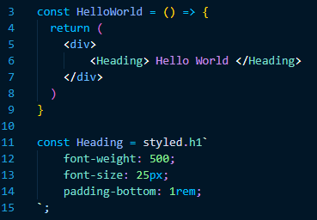
Prerequisites for Learning React
A visualization of JSX :

Slide 10

Prerequisites for Learning React
Node.js is required to start hosting a virtual server for developing React applications.
Furthermore, a Node.js runtime environment is one of the base requirements in installing package managers, namely :
NPM, by default, comes with Node.js and contains an official registry of external libraries, ready to be installed by commands
Yarn maintains the same role, albeit does not come with Node.js by default. Rather, it is an independent 3rd-party software with an emphasis on speed, security, and consistency of module installations.
Cc : Freepik

Slide 11
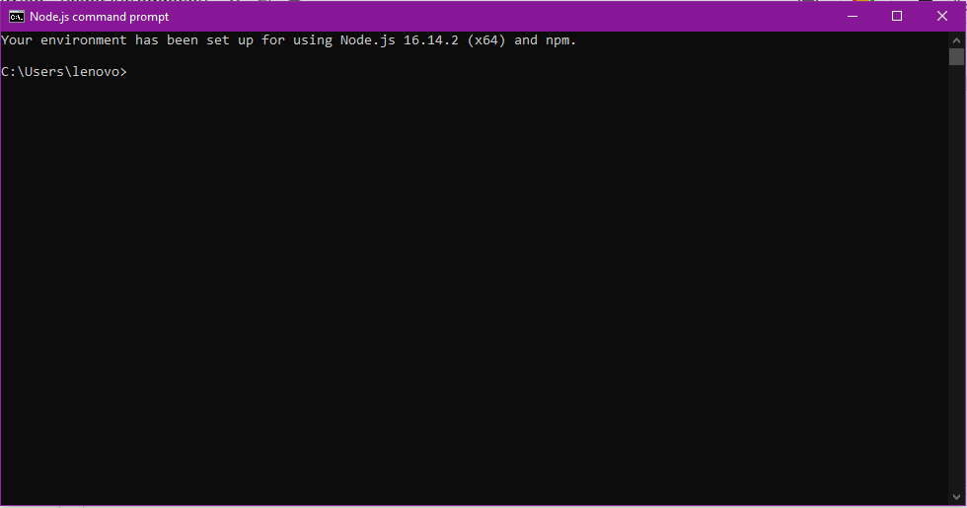
Prerequisites for Learning React
An example of a Node.js terminal:

Slide 12

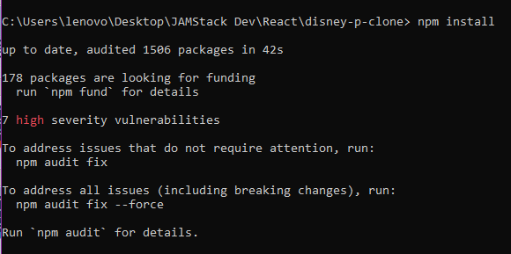
Prerequisites for Learning React
Package managers and related software aids in the automation of installation, update, configuration, and deprecations of external libraries or “packages”.
The following lists the standard package-management system for React:
NPM is bundled in a Node.js Runtime Environment, and is available upon Node.js installation. It is written in the following command form:
npm install >package-name>
Yarn operates in a similar manner with :
yarn add <package-name>
Cc : Freepik

Slide 13
Prerequisites for Learning React
Git is a version-control system used for real-time collaboration and documentation between developers, often in remote teams.
utilizing a Node.js terminal or Git Bash, the system allows teams to “pull” a request or clone a Github repository, and then push updates to the code - a redundancy against inconsistent code.
Git is best used with Microsoft Visual Studio Code due to its integrated Git extensions or plugins and direct Github connectivity.
Cc : Freepik

Slide 14
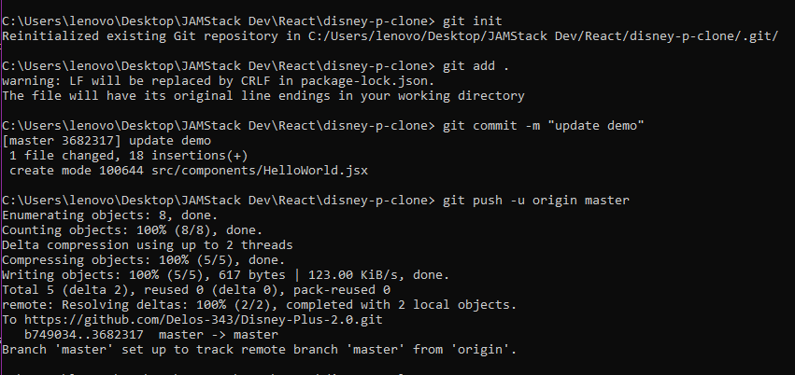
Prerequisites for Learning React
A Git instance running on a Node.js terminal:

Slide 15
Ways to install React.JS
To setup a React project calls for the creation of a stable runtime environment and virtual server to host the application. To do this requires Node.js.
However, a React App has a basis in two components:
Babel is a Javascript transpiler, converting code into another form - in this case, from XML to base Javascript as used on the web.
Webpack is a module bundler used to quickly swap or load independent modules.
Cc : Freepik
pch.vector - freepik.com

Slide 16

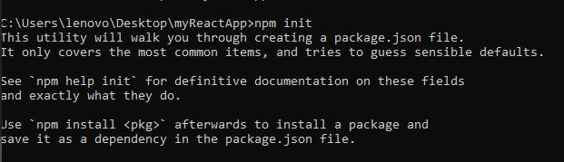
Ways to install React.JS
To install a React.JS application manually, a directory must first be made as a root folder.
n
n
n
Once the folder has been created, track the directory and initialize an empty Git repository

Slide 17
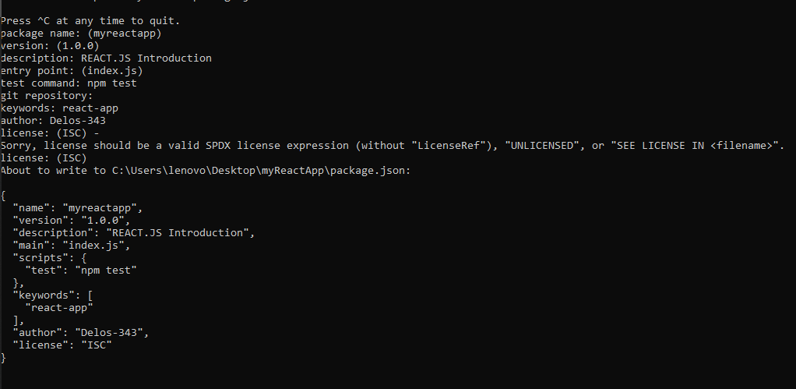
Ways to install React.JS
Once done, the terminal will ask for the user to fill in the blanks accordingly. This will also initialize a package.json file.

Slide 18

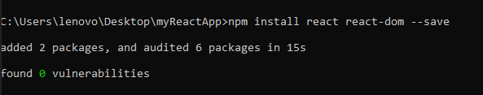
Ways to install React.JS
Press any button to confirm the project with a name of your own choosing.
.
Install React and React-Dom, this can be done in a single command:.

Slide 19
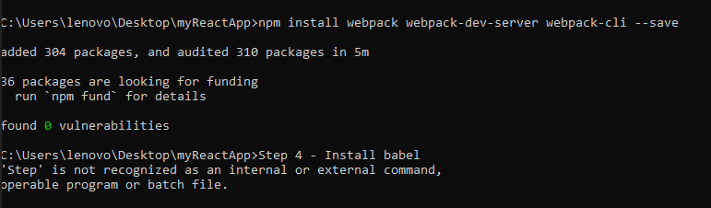
Ways to install React.JS
The next step is to install webpack, webpack-dev-server and webpack-cli.

Slide 20
Ways to install React.JS
Install Babel and its plugins:
babel-core, babel-loader, babel-preset-env, babel-preset-react and, html-webpack-plugin

Slide 21
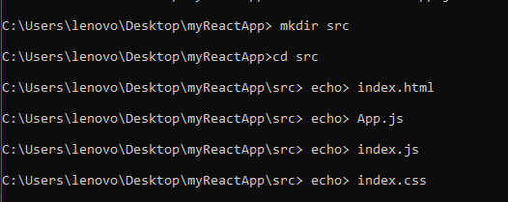
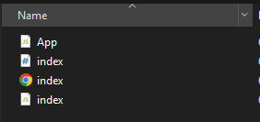
Ways to install React.JS
Create a source folder with the following files:
index.html
App.js
index.js
index.css

Slide 22

Using the create-react-app command
Alternatively, one can simply run the create-react-app command
Node.js and accompanying package managers (NPM, Yarn) must be installed beforehand
Ensure that the root directory is created with access to a secure network connectivity

Slide 23
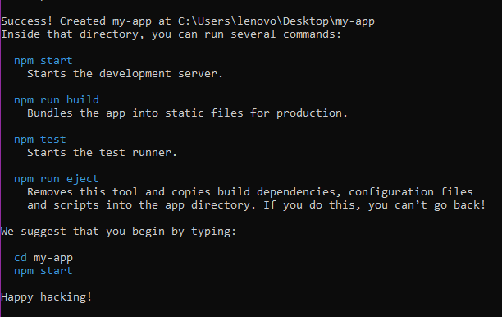
Using the create-react-app command
If successful, the results should look like this:

Slide 24

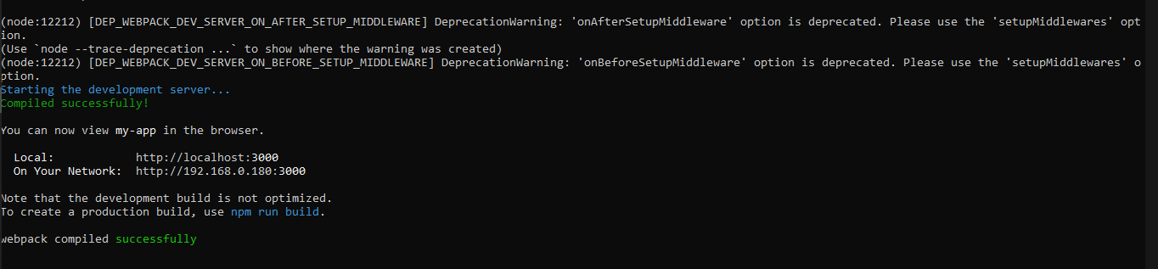
Using the create-react-app command
To jumpstart the application, change the directory into the project folder and run the command:
The app is accessible through localhost:8000

Slide 25
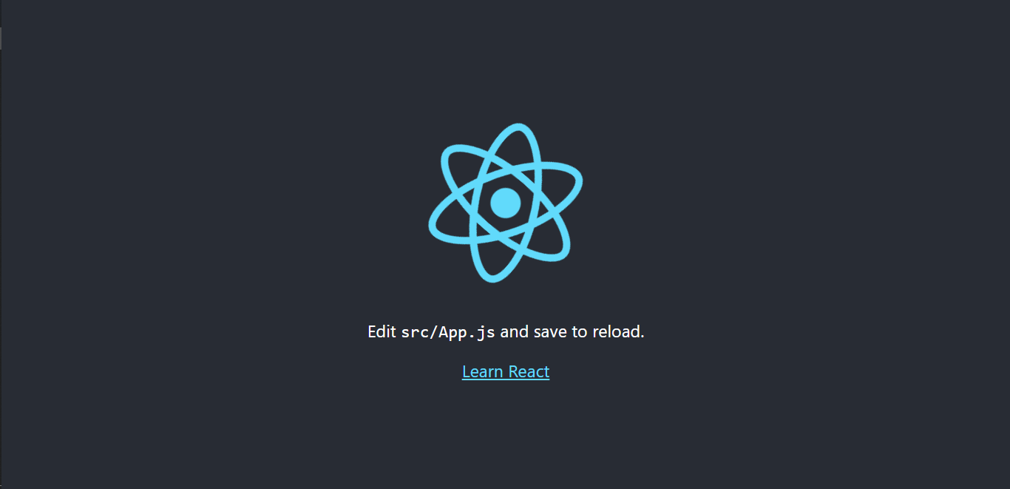
Using the create-react-app command
The application should look like this:

Slide 26
References
https://codersera.com/blog/why-learning-reactjs-makes-sense-in-2020/#:~:text=Why%20you%20should%20learn%20ReactJS,thinking%20behind%20'Design%20Systems'.
https://www.codecademy.com/resources/blog/3-reasons-to-learn-react/
https://www.freecodecamp.org/news/learning-react-roadmap-from-scratch-to-advanced-bff7735531b6/
https://www.tutorialspoint.com/reactjs/reactjs_environment_setup.htm
https://docs.microsoft.com/en-us/windows/dev-environment/javascript/react-on-windows
https://leanpub.com/reactjs-documentation-pdf

Slide 27
REACTJS
React Introduction
Calvin Susanto Putra

Slide 28
Kelengkapan Modul
Pre & Post Test (minimal 10 soal, pilihan ganda a-d)
Pre Reading
Teaching Notes
Referensi

Slide 29
Assessment – [Pre & Post Test]

Slide 30

Pre-Reading
ReactJS is a Javascript library for building user interfaces. This PDF ebook is a portable offline reference guide for the community, can be printed or synced with your kindle for a better reading experience. It's based on ReactJS version v.16.13.1
This is an excellent reference format for ReactJS beginners, is not a tutorial just the official documentation for your reference

Slide 31
TEACHING NOTES*
Lesson/Topics
Case Study
Clips
Games
Others : . . . . . . . . . . . .
OBJECTIVES
PERSIAPAN
Memahami tentang konsep dasar nya ReactJS
Offline: Laptop
Online: Link Zoom
OVERVIEW
DIRECTION
React adalah framework untuk bahasa pemrograman Javascript yang digunakan untuk membuat user-interfaces (UI) yang interaktif dan dinamis. React dibangun oleh Facebook pada tahun 2011, dengan rilis ofisial dan umum pada 2013.
Menjelaskan apa, bagaimana dan tujuan dari kegiatan;
Mengatur dan mengelola arah dan jalan-nya diskusi;
Memberikan contoh-contoh, kasus dan ilustrasi;
Memberikan apresiasi dalam tanya jawab;
Memberikan debrief atau insight/pesan dari kegiatan;
Memberikan dan menyampaikan kesimpulan dan di tiap sesi atau di akhir sesi
PERALATAN YANG DIBUTUHAN
Offline : Laptop
Online: Link Zoom
*Catatan : jumlah halaman teaching Note dapat ditambah seauai kebutuhan

Slide 32
TEACHING NOTES 2/2*
DIRECTION
Section (slide/clip/case/etc) | Activities (Hal apa yang akan dilakukan untuk setiap section-nya) | Description (hal-hal spesifik yang harus dilakukan, misal : penjelasan dan atau penekanan materi, pengelolaan arah dan jalannya diskusi, wrap up/insight atau debrief, etc)
5 | Presentasi, Diskusi | Menjelaskan tentang gambaran umum tentang React
6 | Presentasi, Diskusi, Case Study | Menjelaskan tentang introduksi React dan kenapa ia popular
7 - 14 | Presentasi, Diskusi, Case Study | Menjelaskan tentang persyaratan dan tools untuk menggunakan React
15 - 21 | Presentasi, Diskusi, Case Study | Menjelaskan tentang installasi React secara manual dan automated
22 - 25 | Presentasi, Diskusi, Case Study | Menjelaskan tentang penggunaan command “npx create-react-app”

Slide 33
References
Ilya Kantor (2022), “Error handling, "try...catch"”, https://javascript.info

